Slide 1
7-GPU Architecture
Dr. Hamish Carr & Dr. Rafael Kuffner dos Anjos

Slide 2
Agenda
How GPU’s work
Modern pipeline
Shaders

Slide 3
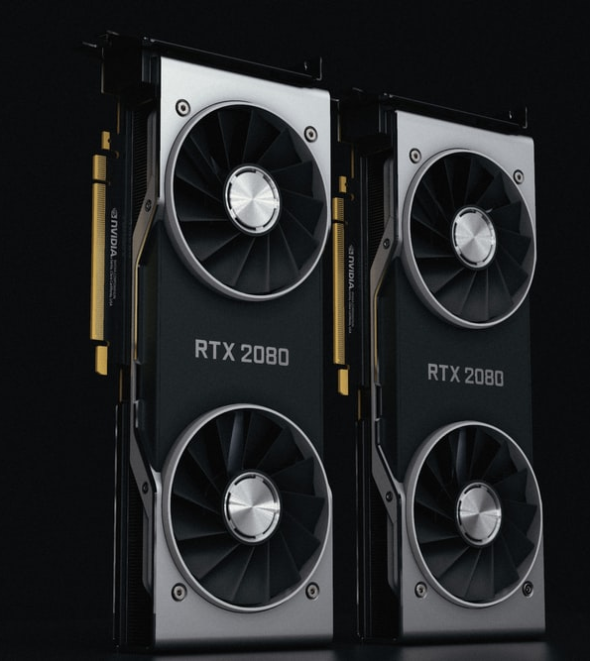

GPUs
Can be discrete or integrated
Many levels, but all have custom silicon
Hardware-software co-design
For 35 years
COMP 5812M: Foundations of Modelling & Rendering
COMP 5812M: Foundations of Modelling & Rendering

Slide 4
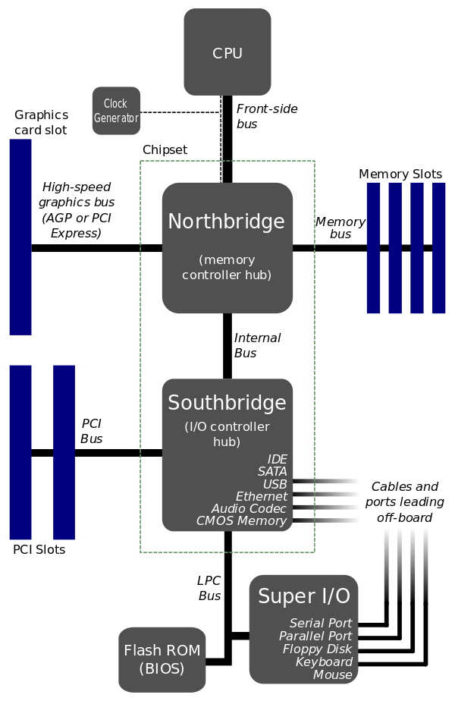
GPU-Centric PC Architecture
Core logic on motherboard
Everything fed to CPU
GPU connected over bus
data transfer limited
Batch transfer preferred
GPU often more powerful
CPU is just the I/O processor

Slide 5
High-Level View of GPU
Massively parallel by design
Many processors interacting
(PC, Mask)
I-Cache
Shader
Core
Shader
Core
Shader
Core
Shader
Core
Decode
…
SIMD Execution
Interconnection network
Scalar Pipeline
Scalar Pipeline
Scalar Pipeline
Scalar Pipeline
…
Memory controller
Memory controller
Memory controller
…
Graphics RAM
Graphics RAM
Graphics RAM

Slide 6
GPU Characteristics
Many shader cores (1000s of processors)
Stream processing
SIMD using warps (NV) / wavefronts (AMD)
Small amounts of per-core memory
High latency to main VRAM
Stalling common when accessing data
But many 1000s of data to be processed
COMP 5812M: Foundations of Modelling & Rendering

Slide 7

Context Switching
A core computes something in register
Then it accesses a texture and stalls
So suspend the thread and start another
And use hardware to perform the switch
Return to first thread after data load done
Minimises downtime, maximises throughput
Because we have so many operations to do
COMP 5812M: Foundations of Modelling & Rendering

Slide 8
SIMD Parallelism
Instructions shared between groups of cores
Called warps (NVIDIA) / wavefronts (AMD)
Usually 8-64 cores mapped to a SIMD lane
Works best with non-branching code
And when memory fetches are few
And when register usage is low
All this affects the occupancy rate
COMP 5812M: Foundations of Modelling & Rendering

Slide 9
Simplified Example

Slide 10
Divergence
If statements stall pipelines
Cores take different branches
Warp threads diverge
Branch to different codepaths
Often controlled by semaphores
Tends to cause bottlenecks
Branch
Path A
Path B

Slide 11
The Modern Pipeline
Fully
Programmable
Configurable
But Not
Programmable
Completely
Fixed Function
Required
Stage
Optional
Stage
Based on the projective rendering pipeline
With extra stages (of course!)
But essentially what we've been implementing

Slide 12
Terminology
Draw call – invocation by the programmer
Uniform input – value constant over draw call
Varying input – value varying per element
Causes pipeline to execute & run shaders
May involve 1000s of vertices

Slide 13
Uniform vs. Varying
Uniform values are the same for all elements
E.g. lighting (i.e. a lot of OpenGL state)
Lots of constant registers available on GPU
Accessible from all cores
Varying values are different for each element
E.g. uv coordinates
Stored in local registers per core

Slide 14
Unified VM Architecture

Slide 15

Input Assembler
Fixed stage before vertex shader
Weaves together data streams
E.g. mixing vertices & normal
Striping data from vertex arrays
Also allows instancing
Reuse of the same object multiple times
COMP 5812M: Foundations of Modelling & Rendering

Slide 16
Vertex Shader
First stage under programmer control
Converts to clip space (required)
May also tweak vertex position, properties
Occurs before lighting computed
E.g. adjusting normal to generate a crease
COMP 5812M: Foundations of Modelling & Rendering

Slide 17
Uses of Vertex Shaders
Deforming an existing mesh
Animation: skinning & morphing
Procedural deformation: flags, cloth, water
Particle creation: from degenerate meshes
Lens distortion, heat haze, &c.
Applying terrain height fields
COMP 5812M: Foundations of Modelling & Rendering

Slide 18
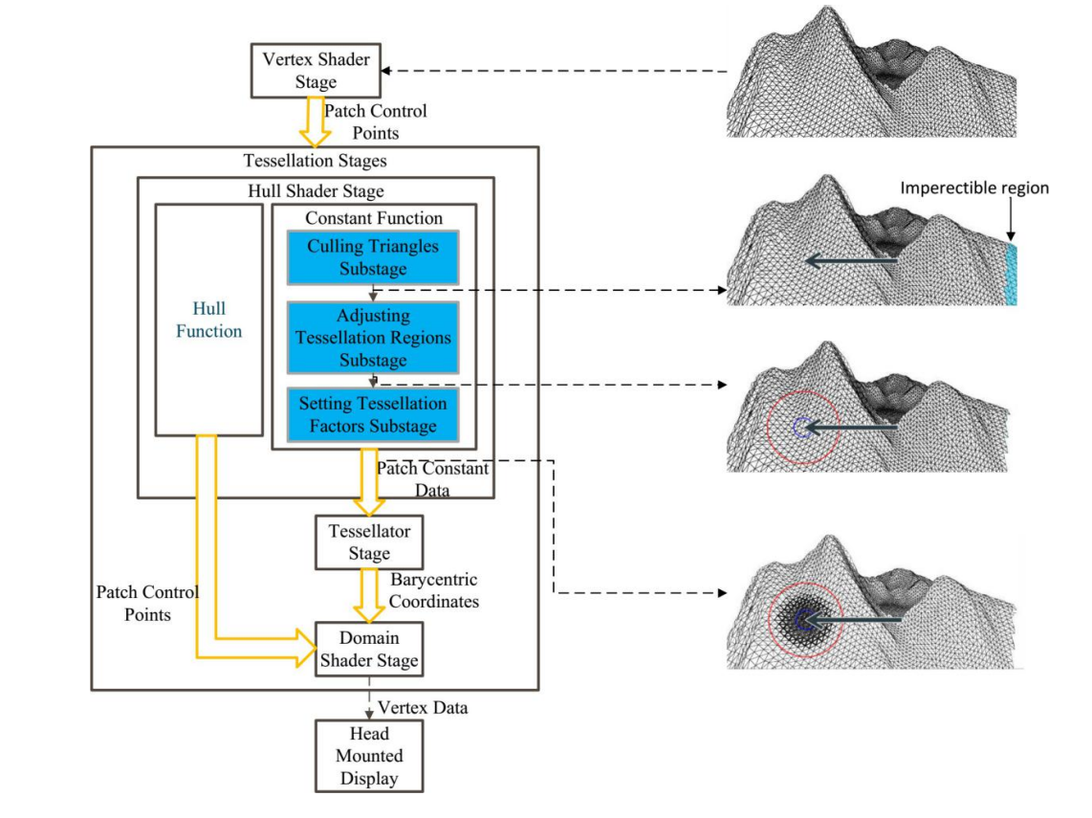
Tessellation Stage
Allows converting mesh into finer mesh
Useful for higher-order surfaces
Saves memory / bandwidth
Consists of three internal stages
Hull shader (tessellation control shader)
Tessellator
Domain shader (tessellation evaluation shader)
Zheng et al. 2020

Slide 19
Tessellation Substages
Hull shader modifies input patch
Tessellator converts to smaller patches
Domain shader generates vertex attributes

Slide 20
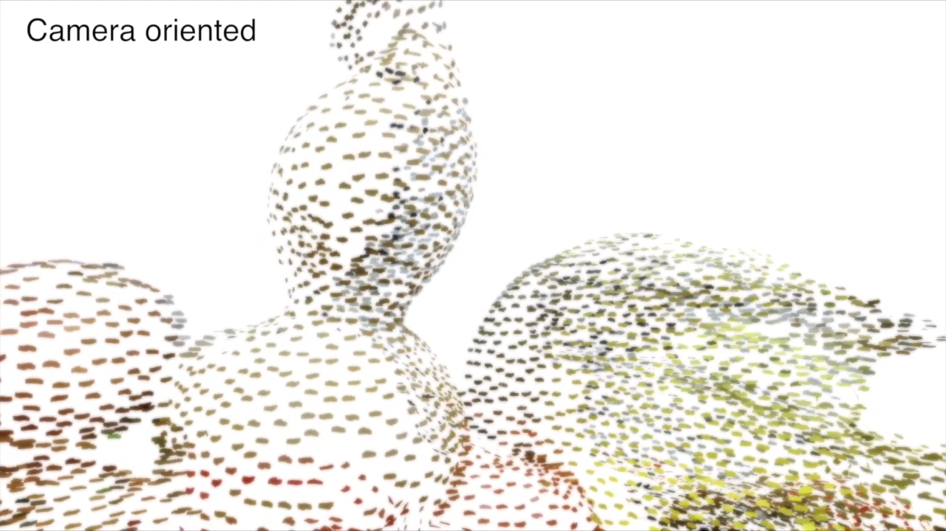
Geometry Shader
Converts primitives into other primitives
E.g. turns mesh into wireframe, point into quad
We will use this for a fur shader next term
Can be used to generate multiple streams
Not the most heavily used
Because it is so general-purpose
Means it is harder to optimise
COMP 5812M: Foundations of Modelling & Rendering

Slide 21
Clipping, Mapping, Raster
Clipping stage trims off-screen portions
Can convert triangle into quad (2 triangles)
Mapping stage is the viewport transform
Rasterisation we know about
Generates fragments
Computes barycentric coordinates
Interpolates attributes from vertices
COMP 5812M: Foundations of Modelling & Rendering

Slide 22

Pixel Shader
Also known as the fragment shader (OpenGL)
Input is fragments with attributes
Typically computes the fragment’s colour
Also opacity, can modify z-depth
Has the ability to discard the fragment
Does not perform the depth test
Can render to multiple targets
COMP 5812M: Foundations of Modelling & Rendering

Slide 23
Clipping in Pixel Shader
Input: nested spheres in different colours
Already rasterised into fragments
Discard any fragments in a known quadrant
Simple geometric test on x,y,z

Slide 24
Multiple Render Targets
We have used a colour and depth buffer
Why limit ourselves to two?
Pixel shader can write to many buffers
And can send output to different places
Eg: colour in one, object IDs in another
Leads to deferred shading
Compute visibility, save attributes for later
COMP 5812M: Foundations of Modelling & Rendering

Slide 25
Pixel Shader Limitation
Pixel shader can only write to its own x,y
Some exceptions in practice
However, different cores can have same x,y
Buffer locking done per-pixel in hardware!
Atomic operation means pixel shader stalls
But this is tolerable in practice, due to high number of fragments
COMP 5812M: Foundations of Modelling & Rendering

Slide 26
Stream Output
Relax the constraint on pixel shader location
Allow it to write anywhere in a buffer
Which then just becomes an arbitrary array
Use the pixel shaders to compute anything
Geometry, vertices, lighting, whatever
Then use the array as input in a second pass
Multi-pass rendering & compute shaders

Slide 27
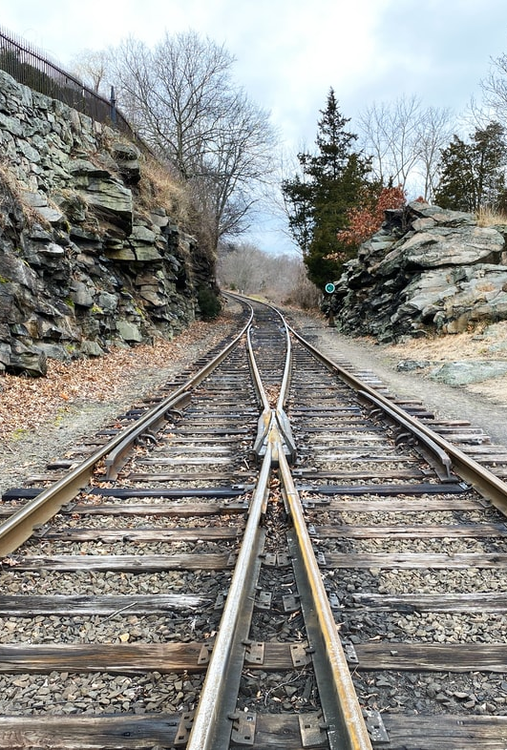
Merging Stage
Output merger (DX) / Per-sample ops (OpenGL)
Combines individual fragments
Essentially doing image processing
Includes depth-test, stencil-buffer, blending
In theory, can save and sort fragments (A-Buffer)
But in practice not common
COMP 5812M: Foundations of Modelling & Rendering

Slide 28

Lighting
The vertex shader doesn’t do lighting
Because we now assume we do Phong shading
I.e. the pixel shader does it per-fragment
Before the z-test
We could test z in pixel shader (early-z: DX 11)
Or we can leave it to merging (DX 12)
Why would we do it that way?
COMP 5812M: Foundations of Modelling & Rendering

Slide 29
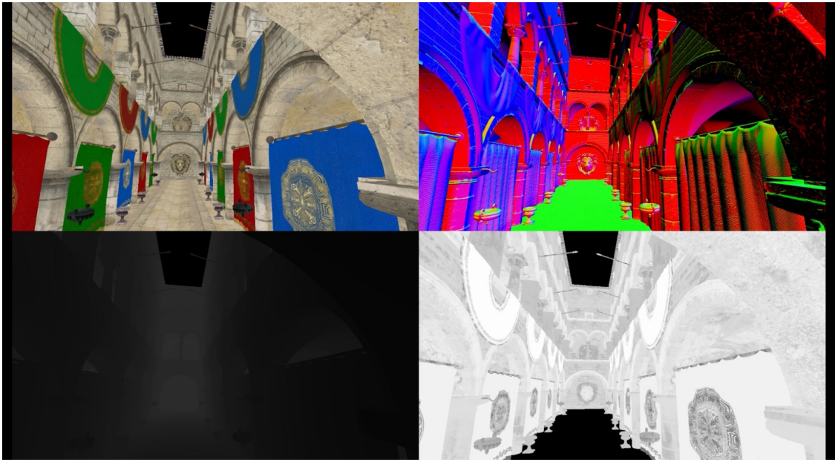
Deferred Shading
Don’t use all the attributes in the first pass
Just use the object ID & the uv coordinates
Framebuffer holds visible object IDs & uv
Now re-render a single quad
Only one fragment per pixel
Lighting computation only done once
Oosten 2015

Slide 30

Net Result
The pipeline stages are malleable
We move computations around all the time
Do NOT assume that this will remain fixed
We may end up doing pure compute
And leaving all of it up to the coder
Until someone simplifies it again

Slide 31
Compute Shader
Throw all of the existing stages out
Just use the GPU as a compute device
Now common for neural nets & other task
Eventually, we may write entire pipelines
But for now, the standard stages are useful
COMP 5812M: Foundations of Modelling & Rendering

Slide 32
Images by
S3: Nana Dua
S7: Mae Um
S22: Umberto
S27: Lance Grandahl

